Slide 1
Academic Exchange Platform CST8288 FINAL PROJECT
JASHANJIT SINGH
CHRIS
MINGAI
MONIKA

Slide 2
PROJECT REVIEW
Purpose of the Academic Exchange Platform: The Academic Exchange Platform aims to create a collaborative environment for academic institutions and professionals.
Key Functionalities Explained:
Registration:
Allows new users (students, professors, or administrators) to create accounts by entering their details.
Ensures secure storage of user information and validation to prevent duplicate entries.
Login:
Provides authenticated access to registered users.
Uses credentials (username and password) to ensure secure access to personalized features and data.
Profile Creation and Management:
Enables users to create and update their profiles.
Users can add personal information, academic details, and professional credentials.
Profiles help in establishing credibility and building a network within the academic community.
Course Management:
Facilitates the addition, modification, and removal of courses by authorized users.
Allows institutions to list courses, manage course details, and update information dynamically.
Provides a centralized course repository for users to browse and enroll.
Search Functionality:
Users can search for courses, instructors, or academic resources.
Implements filters and keywords to streamline results, helping users find relevant information quickly.

Slide 3
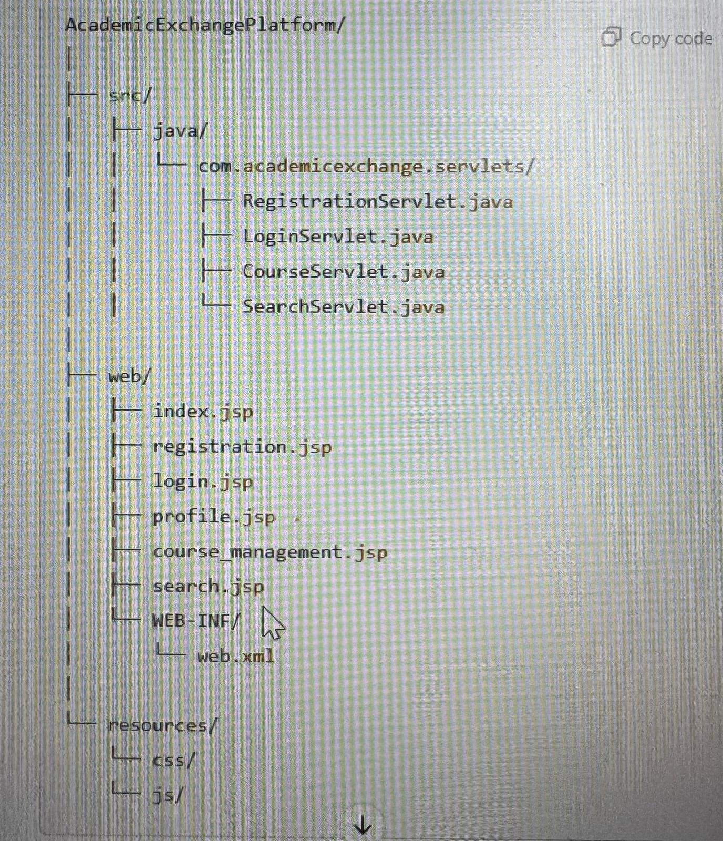
PROJECT REVIEW
Title: Project Structure Overview
Image:
Explanation:
src/java/com.academicexchange.servlets/:
RegistrationServlet.java: Manages user registration.
LoginServlet.java: Handles user login.
CourseServlet.java: Manages course-related functionalities.
SearchServlet.java: Provides search capabilities.
web/:
JSP files for each functionality (registration, login, profile, course management, search).
resources/: Contains CSS and JS for the front-end.

Slide 4
CORE FUNCTIONALITIES
Title: Core Functionalities
Bullet Points:
Registration and Login: Explain how users register and log in.
Profile Management: Describe profile creation and updates.
Course Management: List how courses are added or managed.
Search Feature: Highlight the search functionality.

Slide 5
CHALLENGES AND SOLUTIONS
Content:
The challenges was to manage the code written by all the group members and combine them.
Secondly to provide the Servelts and jsps to Chris so that it can be connected to the SQL.
Solution:
The team managed everything and co ordinated which helped us to complete this project.

Slide 6
So this was the presentation of our Demo we did collectively and we hope this was best.

